Slide 1
AI Tools for Daily Life
(أدوات الذكاء الاصطناعي للحياة اليومية)

Slide 2
outline
Precision Facial Retouching (تحسين دقيق للوجه)
Real-time Face Swapping (تبديل الوجوه في الوقت الحقيقي)
Dynamic Face Integration (دمج الوجه الديناميكي)
AI-Driven Actor Simulation (محاكاة الممثل بالذكاء الاصطناعي)
Image Transformation & Enhancement (تحويل وتحسين الصور)
Safe Media Creation (إنشاء وسائط آمنة)
Geospatial Intelligence Platform (منصة الاستخبارات الجغرافية المكانية)
AI-Powered Interactive Mapping and Geographic Data Visualization (الخرائط التفاعلية وتصور البيانات الجغرافية المدعومة بالذكاء الاصطناعي)
Geolocation Intelligence & Satellite Imagery Analysis (تحليل الموقع الجغرافي وصور الأقمار الصناعية)

Slide 3

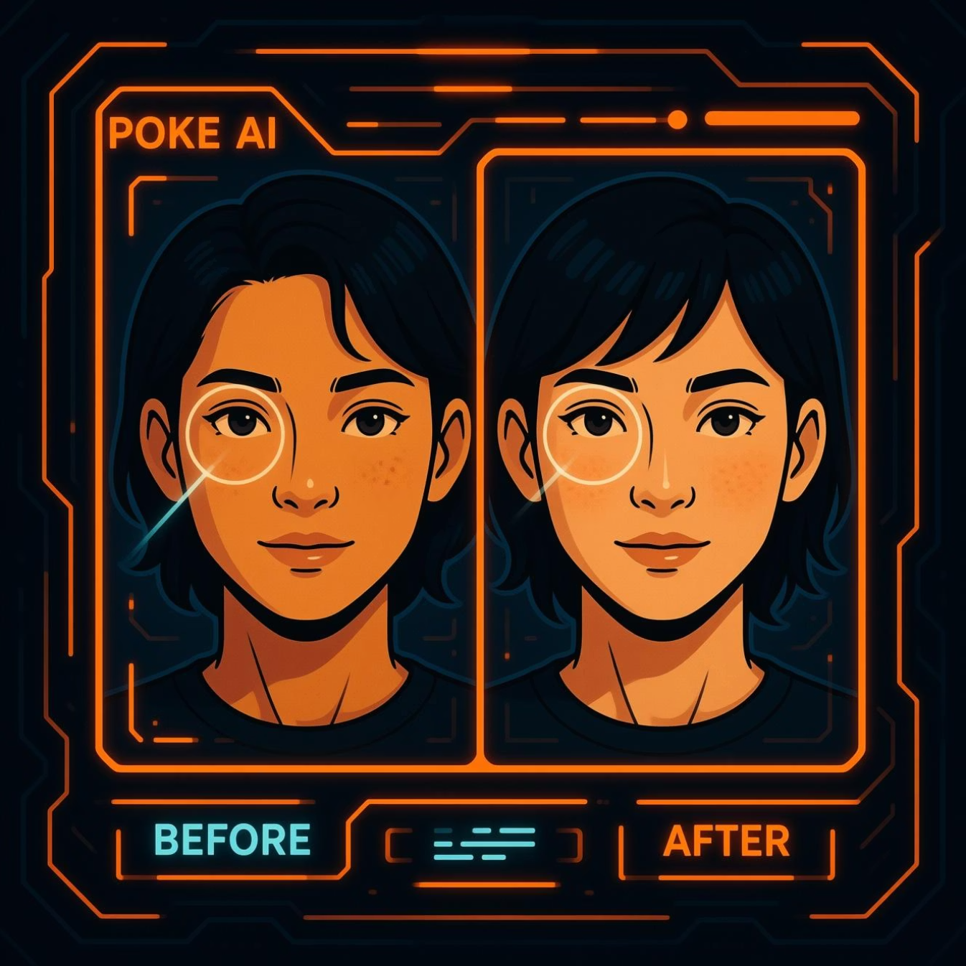
Face Poke: Precision Facial Retouching
Face Poke uses advanced AI to offer precise control over facial features, enabling realistic and subtle edits for photos and videos.
Steps to Use
Upload your image or video to the platform.
Select the specific facial feature you wish to adjust.
Utilize AI-powered sliders and tools for fine-tuning.
Preview changes and export your refined media.
Practical Example: A filmmaker uses Face Poke to subtly de-age an actor for a flashback scene, maintaining visual consistency.

Slide 4


Swapface: Real-time Face Swapping
Swapface offers real-time face-swapping capabilities, allowing users to seamlessly replace faces in live streams, video calls, or pre-recorded content.
Upload Media
Import your source video or connect to a live camera feed.
Choose Target Face
Select a desired face from your library or a template.
Apply & Stream
The AI processes the swap in real-time, ready for broadcast.
Export Result
Save the final video or continue with the live output.
Practical Example: Content creators use Swapface for comedic skits, transforming into different characters instantly during a live broadcast.

Slide 5

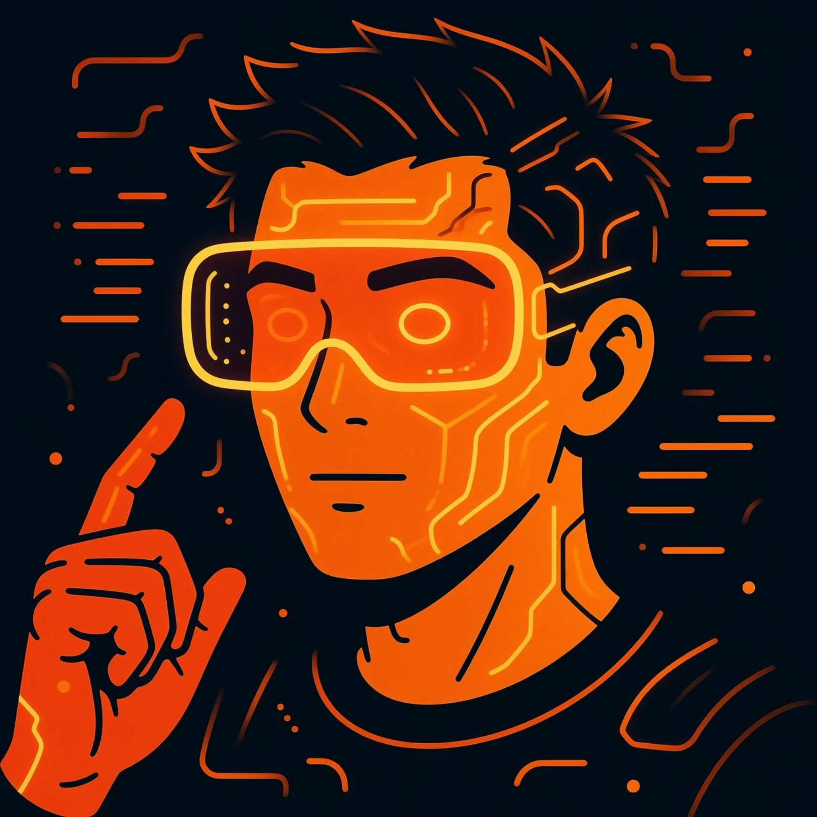
Face in Live: Dynamic Face Integration
Face in Live specializes in integrating faces into various digital scenarios, from augmented reality filters to interactive virtual environments, ensuring natural expression and movement.
Key Steps
Capture or upload a face scan/photo.
Select a desired AR filter or virtual scene.
Calibrate facial landmarks for optimal tracking.
Engage with the integrated face in real-time.
Practical Example: A game developer uses Face in Live to allow players to project their own faces onto in-game avatars for a personalized experience.

Slide 6
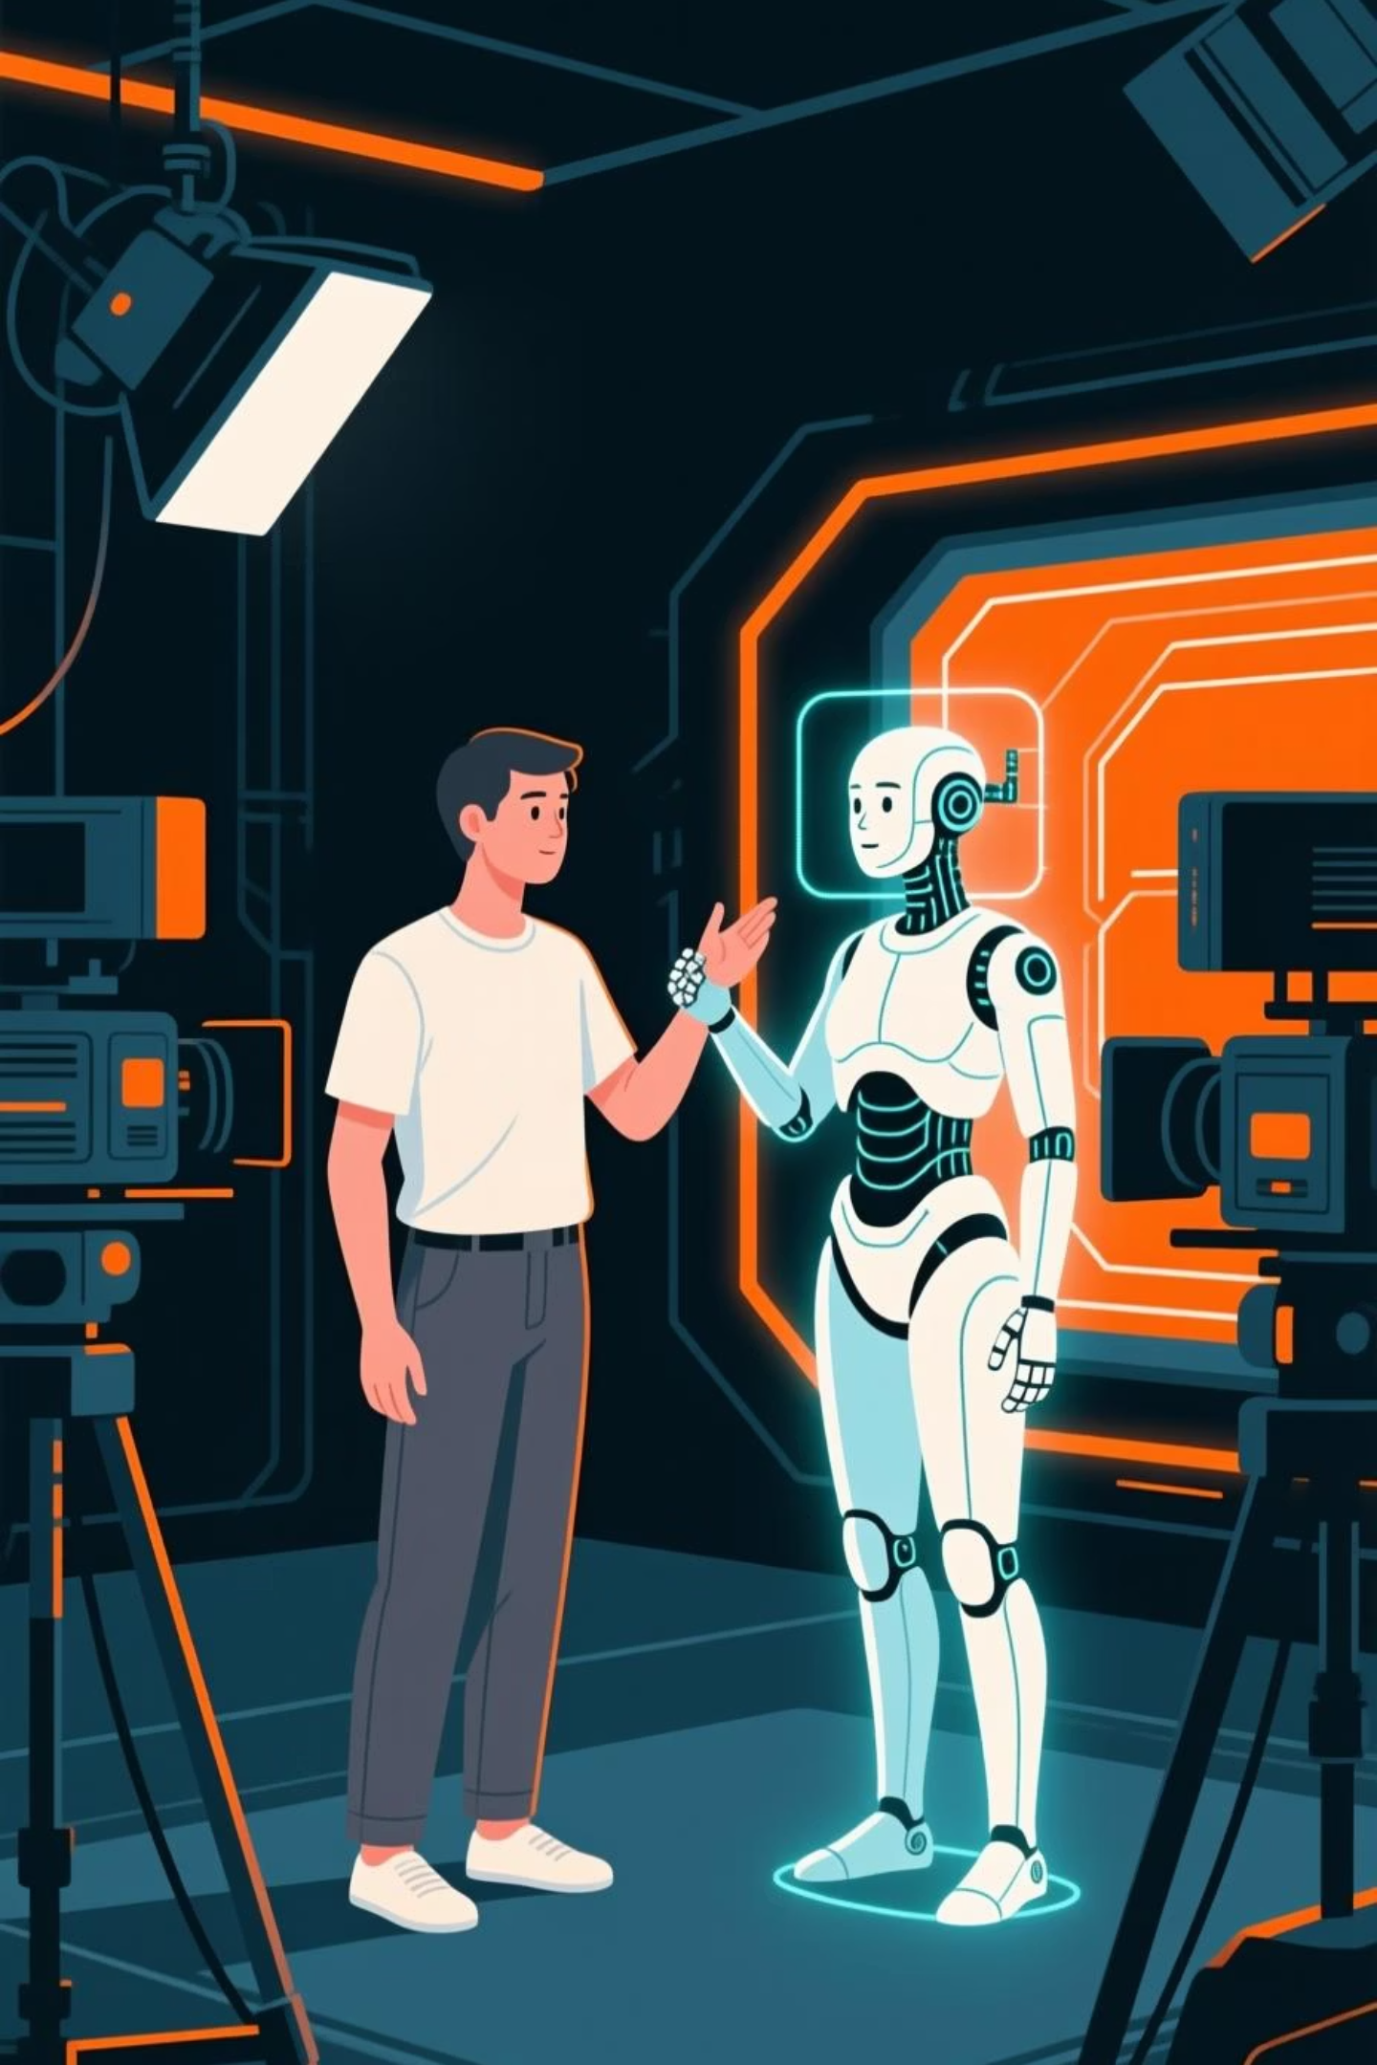





DreamActor-M1: AI-Driven Actor Simulation
DreamActor-M1 leverages AI to generate realistic digital actors, capable of performing custom scripts and emotions, ideal for virtual productions and synthetic media.
Define Script
Input dialogue and stage directions for your virtual actor.
Design Character
Customize appearance, voice, and emotional range.
Generate Performance
AI animates the actor based on the script and traits.
Integrate & Export
Incorporate the performance into your project.
Practical Example: Marketing agencies create hyper-realistic product demonstration videos with AI actors, reducing production costs and time.

Slide 7
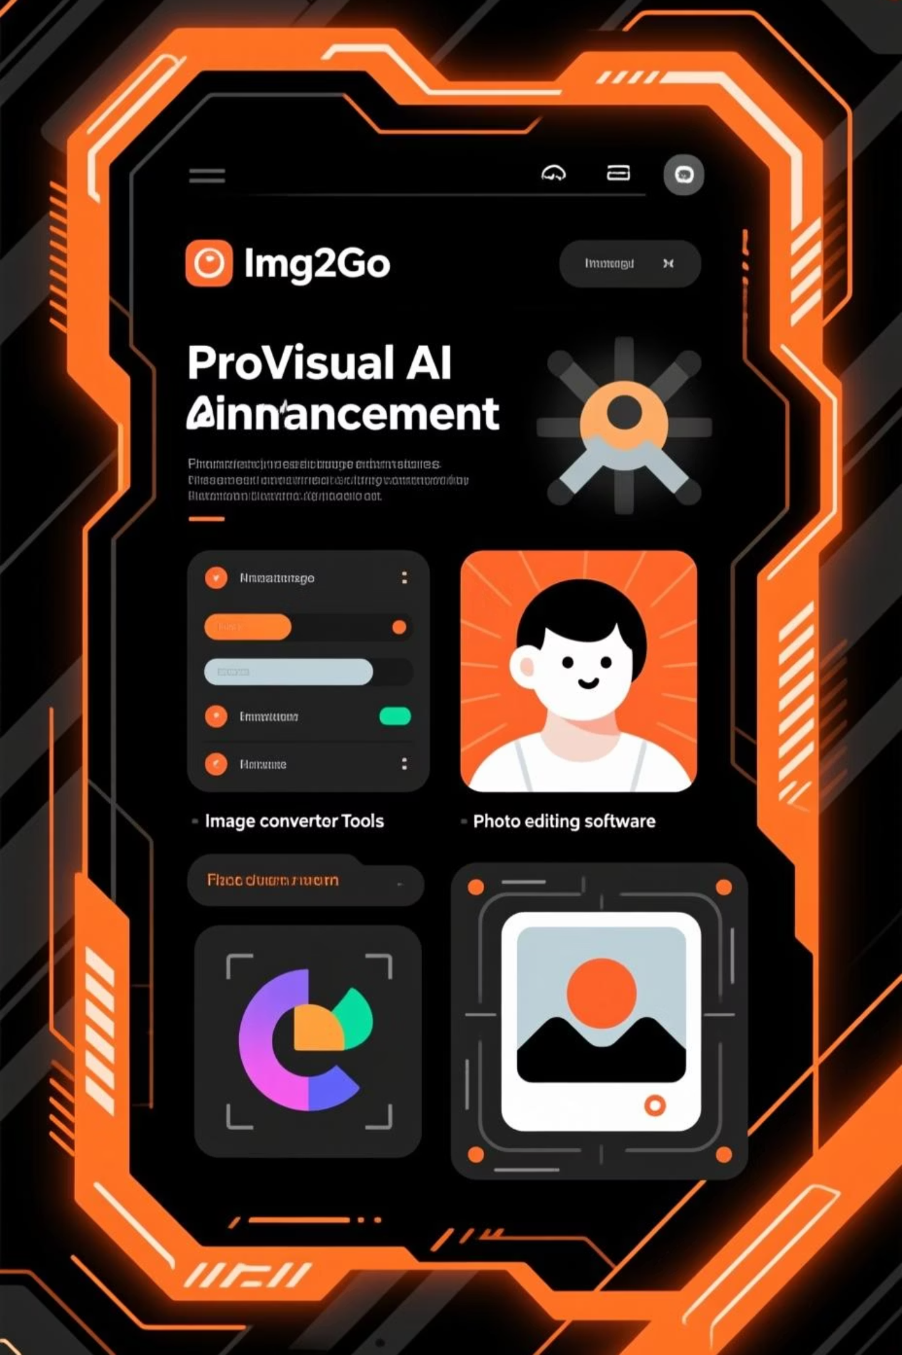


Img2Go & ProVisual: Image Transformation & Enhancement
Img2Go offers a suite of online tools for quick image conversions and basic editing, while ProVisual provides advanced AI-driven image analysis and enhancement for professional applications.
1
Upload Image
Submit your image file to either platform.
2
Select Tool
Choose from various options like conversion, resizing (Img2Go), or intelligent enhancement (ProVisual).
3
Apply & Process
Utilize AI algorithms to perform the desired transformation.
4
Download Result
Obtain your modified and enhanced image.
Practical Example: A graphic designer uses Img2Go to quickly convert image formats and then ProVisual to upscale resolution and remove imperfections from a key visual.

Slide 8


No More Copyright: Safe Media Creation
No More Copyright is an AI-powered platform designed to generate copyright-safe media, including images, music, and text, ensuring creators can focus on innovation without legal concerns.
Steps to Generate Safe Media
Input your creative brief or content requirements.
Specify the type of media needed (image, music, text).
AI generates unique, original, and copyright-free assets.
Review and download media with clear usage rights.
Practical Example: A small business creates marketing campaigns entirely with AI-generated, copyright-free images and jingles, avoiding licensing fees and legal complexities.

Slide 9


Atlas: Geospatial Intelligence Platform
Atlas is an advanced AI-driven geospatial intelligence platform designed for academic and professional users, integrating diverse data sources to deliver comprehensive and actionable insights for complex research and planning.
Key Features
Data Fusion
Seamlessly integrates satellite imagery, drone data, IoT sensor feeds, and traditional GIS layers for a unified geographic perspective.
Predictive Analytics
Leverages machine learning for advanced predictive modeling, anomaly detection, and object recognition within spatial datasets.
Custom Visualization
Offers flexible tools to create interactive maps, 3D models, and dynamic dashboards tailored to specific research and presentation needs.
Applications
Urban Planning
Analyzes population density, infrastructure development, and environmental impact to inform sustainable city growth and resource allocation.
Ecological Research
Monitors environmental changes, tracks biodiversity, and supports conservation efforts with high-precision geospatial data.
Disaster Response
Provides real-time insights for assessing vulnerabilities, planning preparedness, and guiding effective mitigation and recovery strategies.

Slide 10
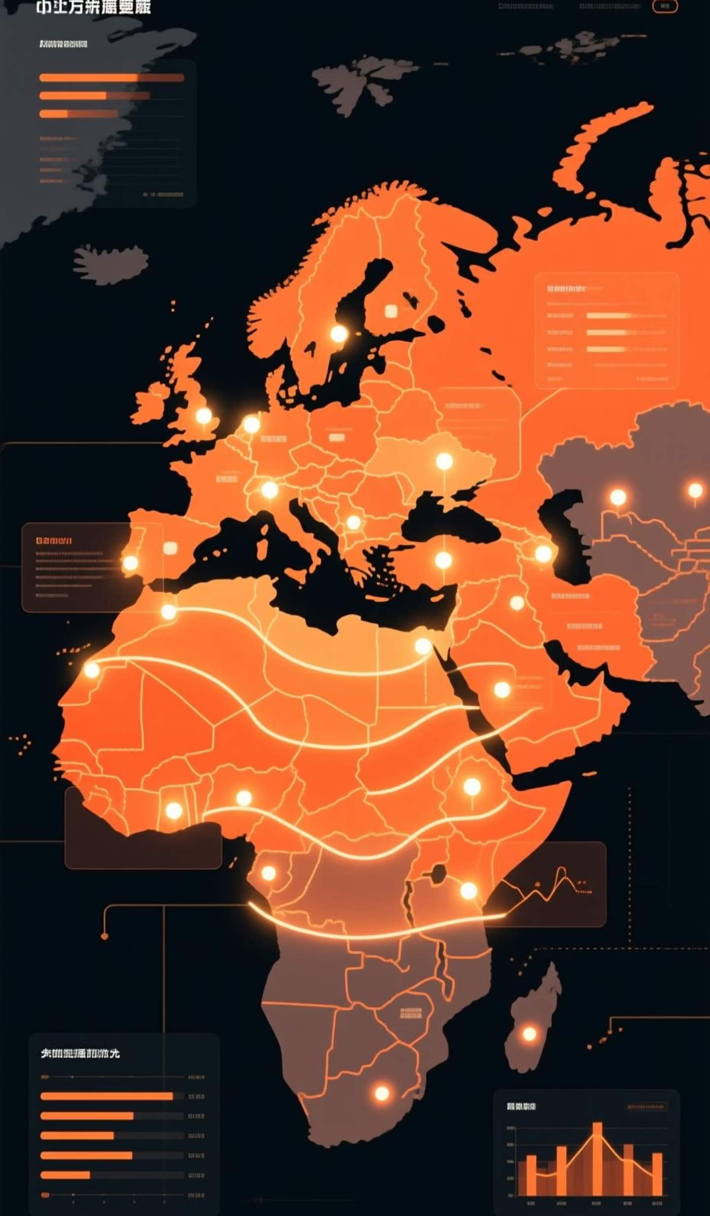





MapScroll: AI-Powered Interactive Mapping and Geographic Data Visualization
MapScroll is an AI-powered platform designed for interactive mapping and advanced geographic data visualization, enabling academic researchers and professionals to explore, analyze, and present complex spatial datasets with unprecedented clarity.
Key Features
Dynamic Data Layering
Overlay diverse datasets like demographics, climate patterns, and infrastructure with intuitive controls for deep analysis.
AI-Driven Insights
Automated identification of spatial patterns, trends, and anomalies through machine learning algorithms.
Collaborative Tools
Share interactive maps and visualizations with colleagues, facilitating joint research and project development.
Real-time Updates
Integrate live data feeds for up-to-the-minute analysis of changing geographic conditions.
Use Cases
Environmental Studies
Urban Development
Visualize deforestation, pollution spread, and biodiversity hotspots for ecological research and conservation planning.
Model city growth, infrastructure needs, and public service accessibility to inform sustainable urban planning strategies.
Epidemiological Tracking
Map disease outbreaks, population density, and healthcare access to support public health interventions.

Slide 11
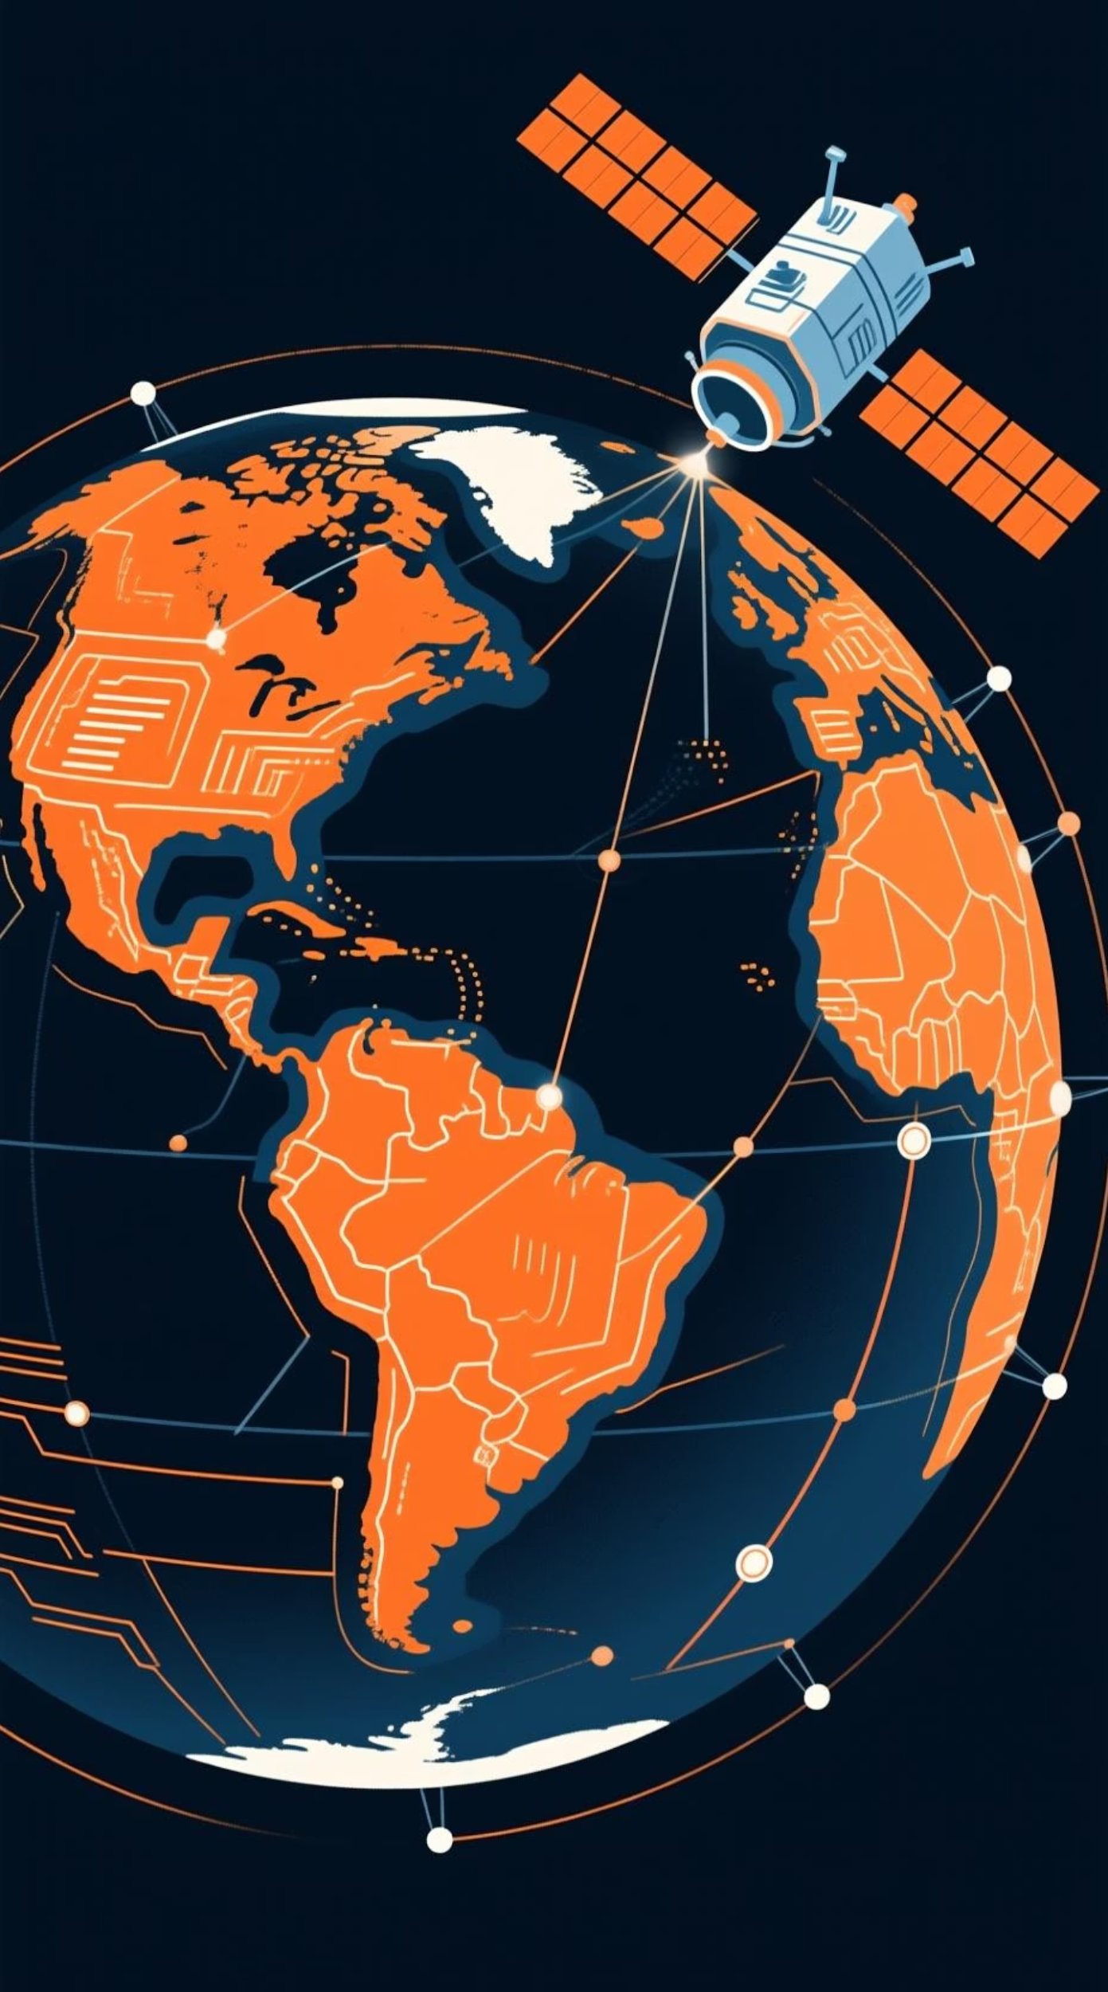




GeoSpy: Geolocation Intelligence & Satellite Imagery Analysis
GeoSpy is an advanced AI-driven platform specializing in geolocation intelligence and satellite imagery analysis, providing critical insights for professionals across various sectors. It transforms raw data into actionable spatial knowledge.
Key Features
High-Resolution Data
Access to up-to-date, high-resolution satellite imagery and aerial data globally.
AI Object Detection
Automatically identifies and tracks specific objects, land-use changes, and critical patterns within imagery.
Integrated Analysis
Combines satellite data with other GIS layers for comprehensive, multi-dimensional spatial analysis.
Temporal Monitoring
Monitor changes over time using historical imagery and advanced predictive modeling capabilities.
Use Cases
Environmental Monitoring
Track deforestation, urban sprawl, and climate change impacts for ecological research and conservation.
Infrastructure Planning
Assess development sites, monitor construction progress, and evaluate existing infrastructure networks.
Security & Defense
Enhance situational awareness, border surveillance, and critical asset protection with precise geolocation.

